Slide 1
Introduction to Computers for Engineers: Recitation #7

Slide 2
Learning Objectives
Understand how to load data from external files (e.g. .csv files)
Continue to develop an understanding of loops
Continue to develop an understanding of arrays
Continue to develop an understanding of MATLAB’s plot functionality

Slide 3
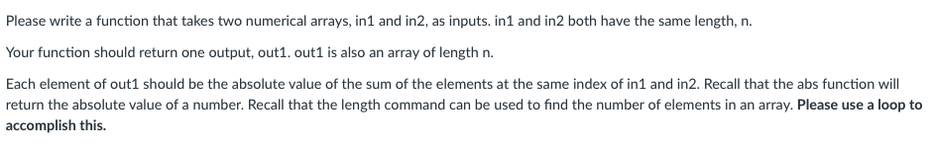
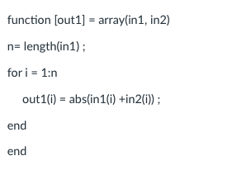
Quiz 4:
Question:
Most seen (incorrect) solution:

Slide 4
We will be working with data!
The data that we will be working with is the average sunlight in Newark, NJ for a given month
The measurement of this data is the Global Horizonal Irradiance
GHI is the total amount of shortwave radiation received from above by a surface horizontal to the ground
GHI’s units are Watts/Meter Squared
For the years 2014 through 2017
The data is in 4 files (one for each year)
Months are sequential
Index 1 is January, 12 is December

Slide 5
Activity 1: Loading in data
Download each of the files for today from the Recitations/Recitation 7 folder on Canvas
Be sure to download them into the same folder as your MATLAB code.
Be sure that the file extension does not get modified in the download process. It should be .csv
Sometimes Safari likes to do weird things to .csv files. Please let us know if you are using Safari and need extra help
If you use MATLAB Online, you will need to upload the files to use them
Use csvread to load the data into MATLAB
Example: data1 = csvread(‘sunData2014.csv’);
In your groups, discuss:
What is the data type of the data?
What important information must be understood by the programmer?

Slide 6
Activity 2: Working with data
We want to compute an array containing the average sunlight in a given month for the years 2014 to 2017 using a for-loop.
Write a script that calculates an array with the average sunlight in each month over the 4 year period
The resulting array should be 1x12
Index 1 should be the average for all Januarys, and index 12 the average for all Decembers
Your script should do the following:
Initialize an array that will hold the averages values (the resulting array)
Contain a loop that counts through indices
Index each array using the loops counting variable
Fill in your initialized array
In your group, discuss:
In what other useful ways could we process this data?
How would we modify our script to perform that data processing?

Slide 7
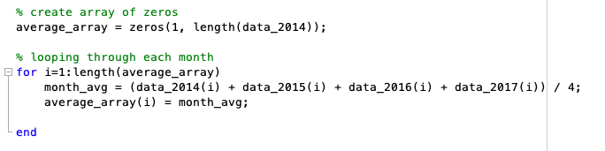
Activity 2: Solution

Slide 8
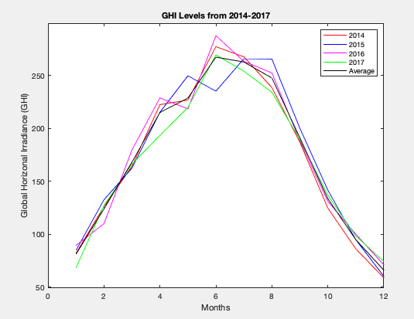
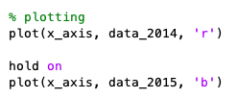
Activity 3: Plotting data in MATLAB
We want to create a plot to compare our averaged array to the data from each year to see how much variation there is
On the same set of axes, plot the 5 different lines using the hold on command
Example:
Your plot should look like figure on the right:
We can label and put legends using the commands:
title – use the command title, as in title(‘This is a title’)
axes labels – use the commands xlabel and ylabel, as in xlabel(‘month’)
legend – use the command legend, as in legend(‘Plot1’, ‘Plot2’….)

Slide 9
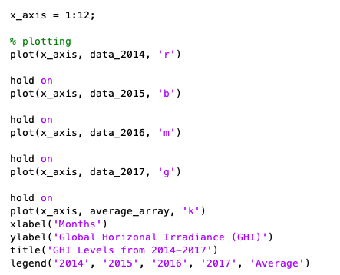
Activity 3: Solution

Slide 10
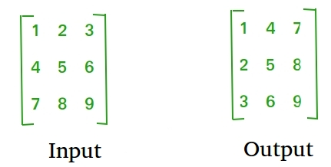
Activity 4: More nested for-loops
We want to write a function called matrixTranspose, with the following:
Input: my_matrix (2D array)
Output: transposed_matrix (2D array)
The purpose of this function is to transpose your input matrix, which is doing the following:
We will only be working with symmetric matrices (e.g. 3x3 matrices). For symmetric matrices, we can just put the (i,j)-th element in the (j, i)-th place.
You want to initialize your output matrix as a matrix of zeros (same size as your input) and fill them in using a nested for-loop.

Slide 11
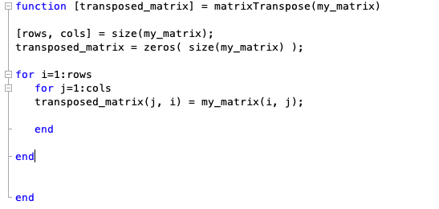
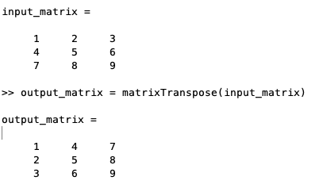
Activity 4: Solution

Slide 12
Activity 5: Even more nested for-loops
We want to write a function called maxElement, with the following:
Input: my_matrix (2D array)
Output: max_val (double)
The purpose of this function is get the maximum value of your input matrix.
You want to initialize your maximum value (max_val) as the first element of your input matrix and then using a nested for-loop, replace that value with an if-statement.
Test your function using test cases.

